Slide 1
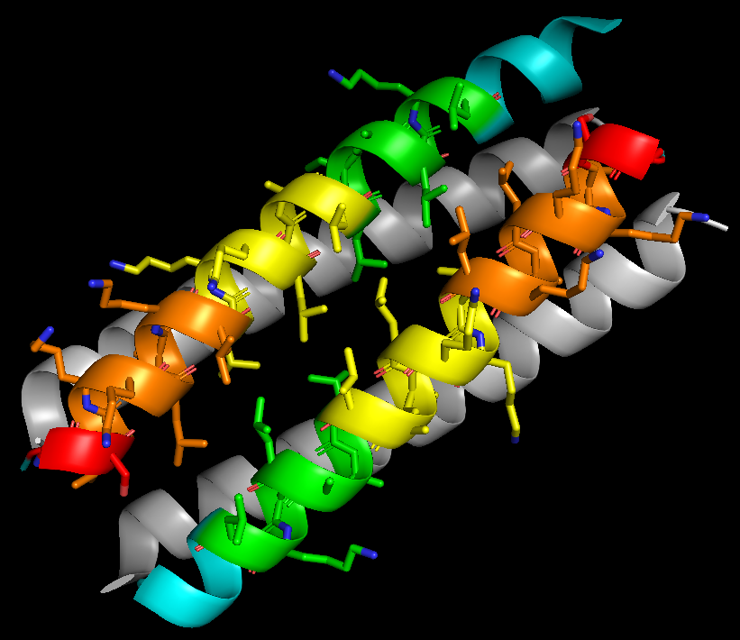
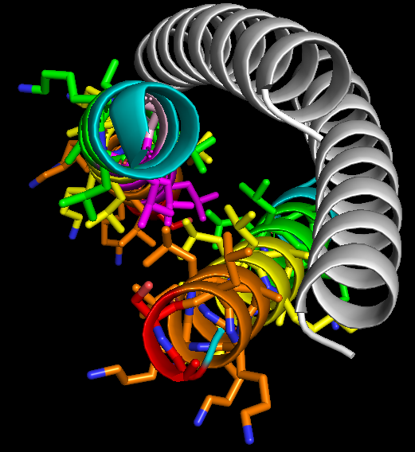
Design Approach: Mutations
Mutation #1: GS-(LKKLAKL)n
abcdefg
Leu & Ala conserved
Converted Glu (-) to Lys (+)
Mutated Leu facing CAP

Slide 2
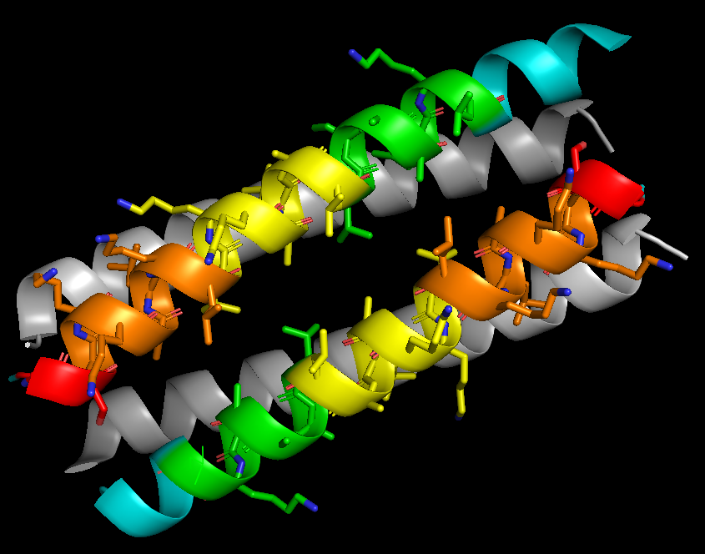
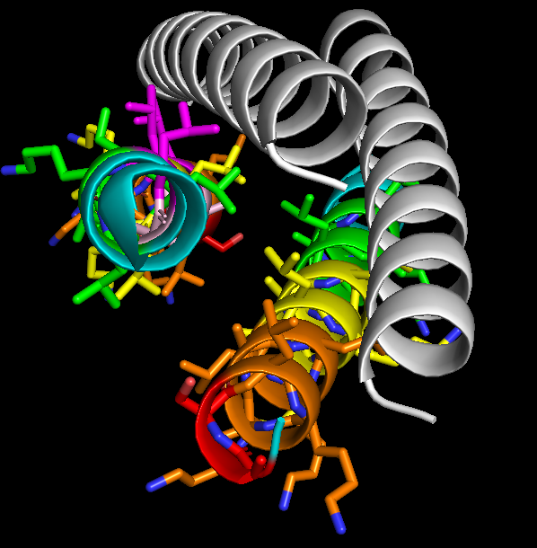
Design Approach: Mutations
Mutation #1: GS-(LKKALKL)n
abcdefg
Leu and Ala switched
Converted Glu (-) to Lys (+)
Mutated Leu facing structural peptide

Slide 3
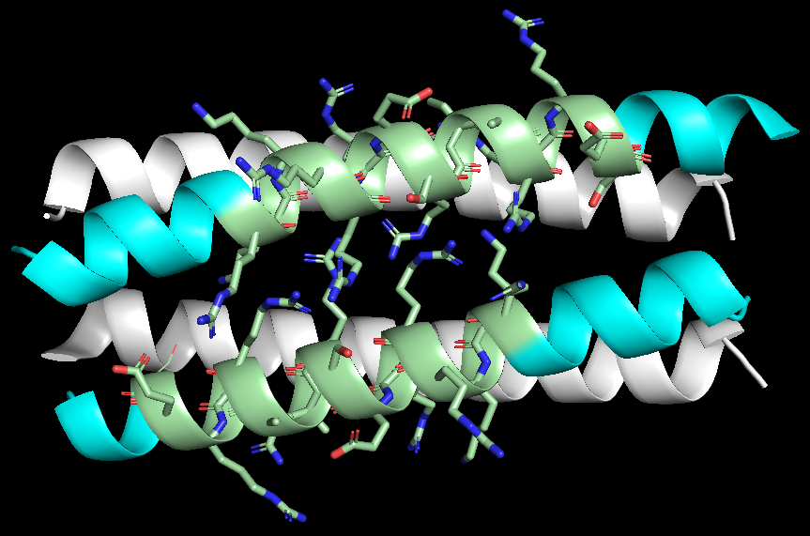
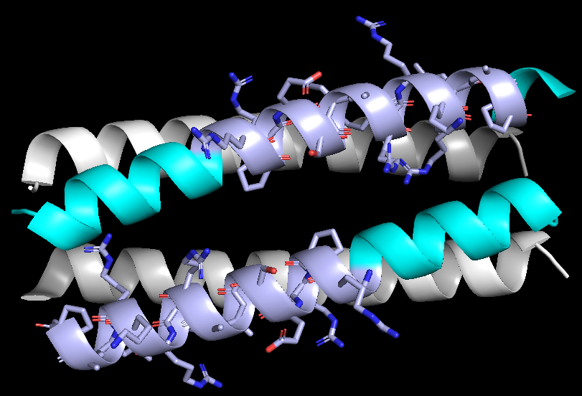
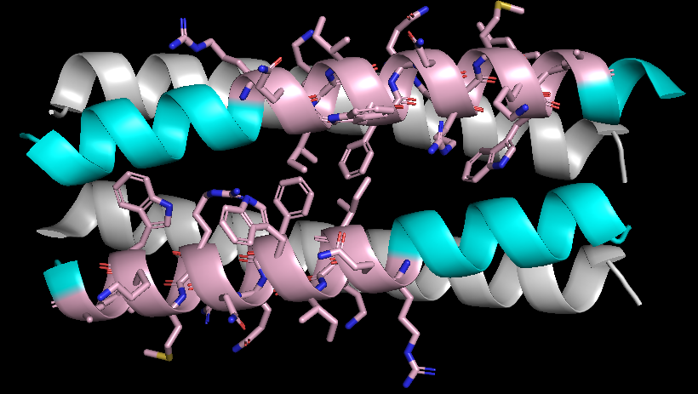
Design Approach: Mutations
CAP | Sequence
DPV3 | RKKRRRESRKKRRRES
DPV6 | GRPRESGKKRKRKRLKP
Penetratin | RQIKIWFQNRRMKWKK
Table of natural CAPs (Xie et al., 2020)
C → N (top); N → C (bottom)
(De coupade et al., 2015)
(De coupade et al., 2015)
(Nielsen et al., 2014)
HMQLEEIAQ-QLEEIAKQLKKIAWQL-KKIAQG
HMQLEEIAQQL-EEIAKQLKKIAWQLKKI-AQG
HMQLEEIAQQL-EEIAKQLKKIAWQLKK-IAQG

Slide 4
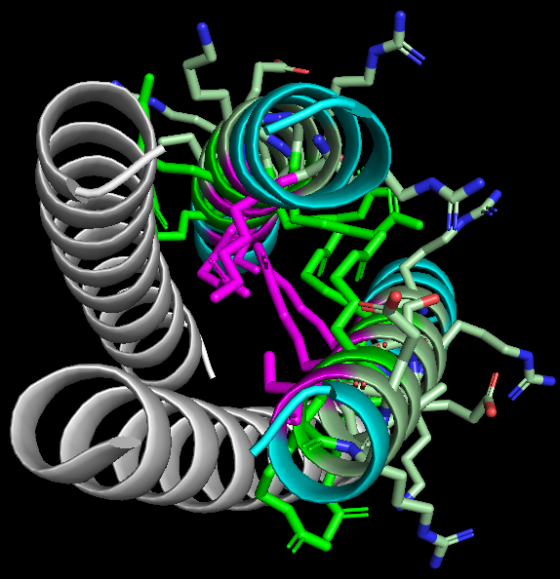
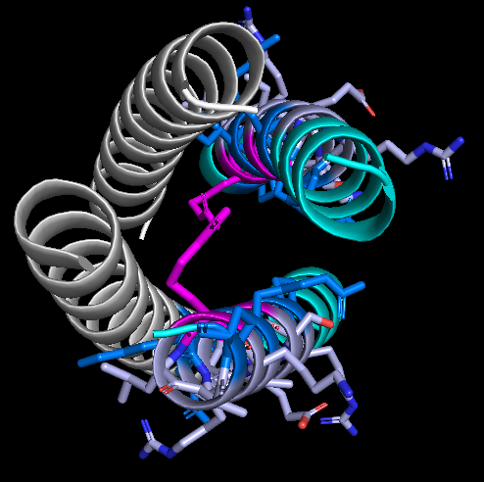
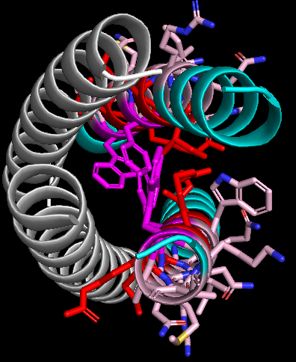
Design Approach: Mutations
Threading natural CAPs hardly follow heptad design rules
*DPV3: RKKRRRESRKKRRRES
*DPV6: GRPRESGKKRKRKRLKP
Penetratin: RQIKIWFQNRRMKWKK
C → N (top); N → C (bottom)
*Charged residues interrupt hydrophobic residues
DPV3 mutant
DPV6 mutant
Penetratin mutant

Slide 5
Design Approach Mutations:
Penetratin | RQIKIWFQNRRMKWKK
Penetratin Attempts
Original sequence: HMQLEEIAQQLEEIAKQLKKIAWQLKKIAQG
Mutation 1 (aromatic residues interrupt core):
Original: HMQLEEIAQQL-EEIA- -KQLK KIAW- -QLKK-IAQG
Mutant: HMQLEEIAQQL-RQIK- -IWFQ NRRM- -KWKK-IAQG
Mutation 2:
Original: HMQL-EEIA- -QQLE- -EIAK- -QLKK-IAWQLKKIAQG
Mutant: HMQL-RQIK- -IWFQ- -NRRM- -KWKK-IAWQLKKIAQG

